Slide 1
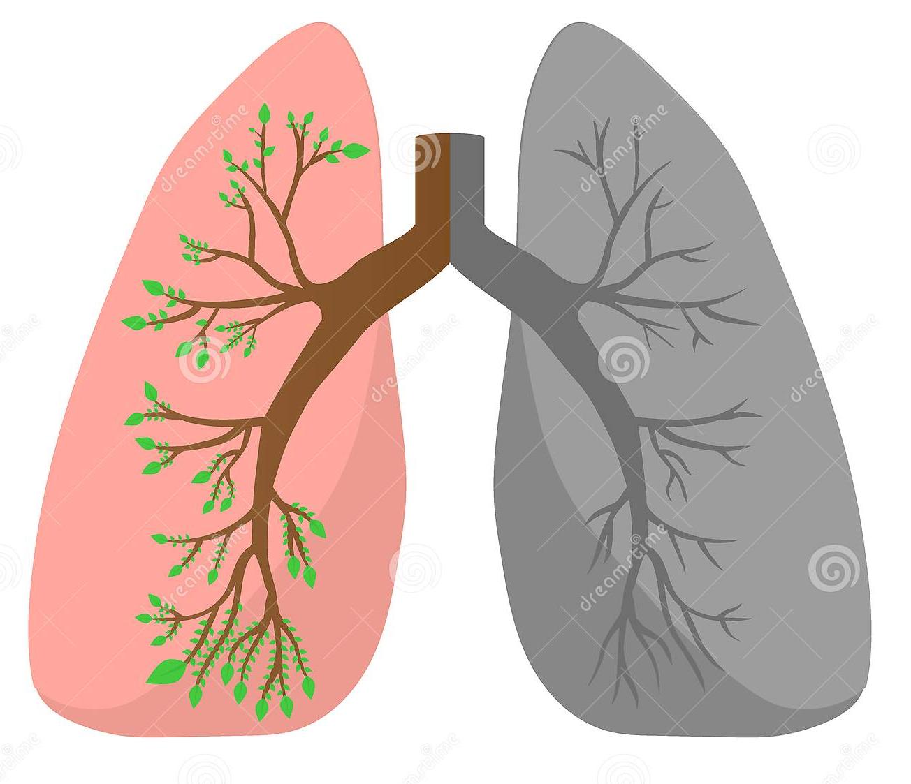
CedMD : Crowdsourcing enhanced DeepLearning based Medical Diagnosis (For Lung Nodule detection)
Bachelor Thesis presentation by Aakanksha Sanctis
Supervisors : Amrapali Zaveri, Deniz Iren, Michel Dumontier

Slide 2
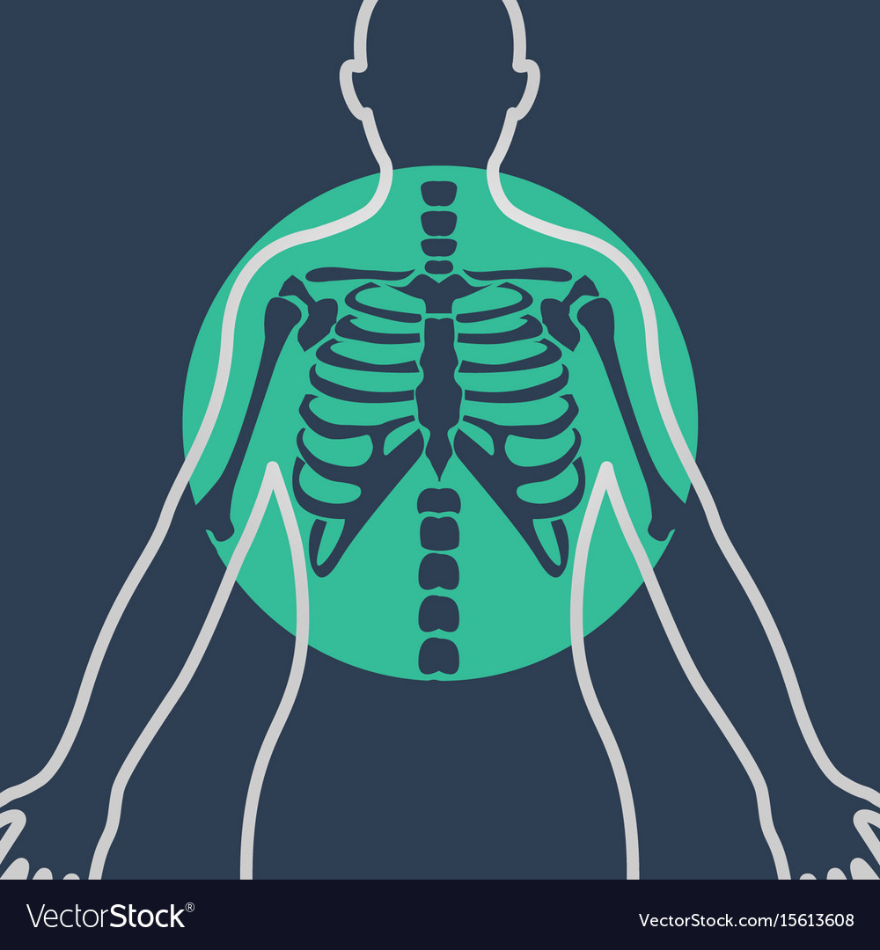
INTRODUCTION
Lung cancer is one of the most deadly cancers in the world, claiming over 2 million lives yearly ^{[1]}
Successful diagnosis currently requires an expert’s take on a CT scan of a patient’s lung
This cannot scale with the ever-increasing amounts of clinical image data analysis can become expensive and time consuming ^{[2]}
Since this is a highly fatal disease, having a second opinion could help reduce the number of misdiagnosed cases.
[1] Global cancer statistics 2018 :CA: A Cancer Journal for Clinician (2018)
[2] Springer. (2013). Medical image computing and computer-assisted intervention.

Slide 3

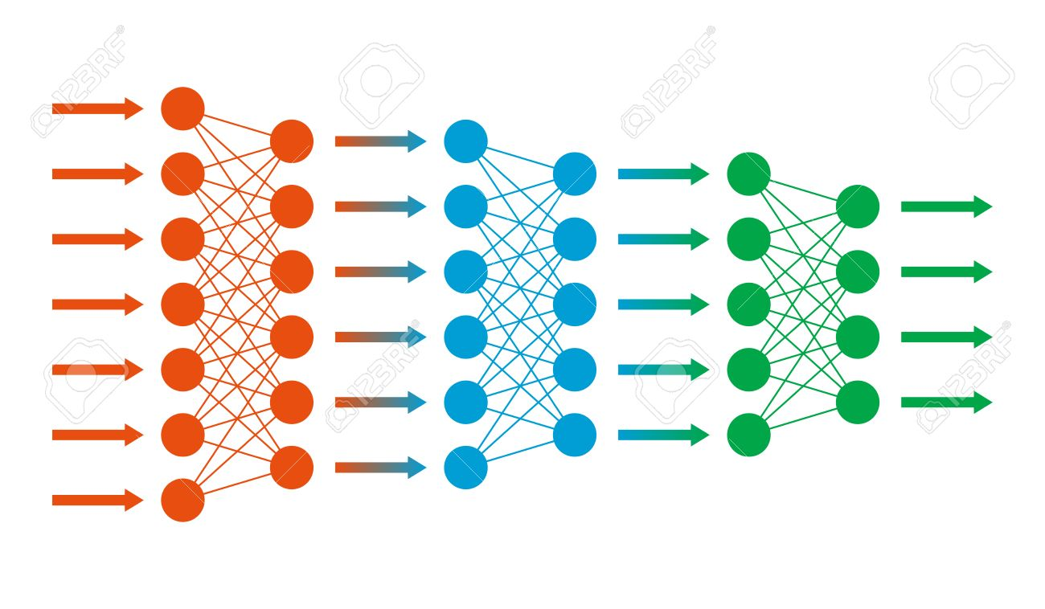
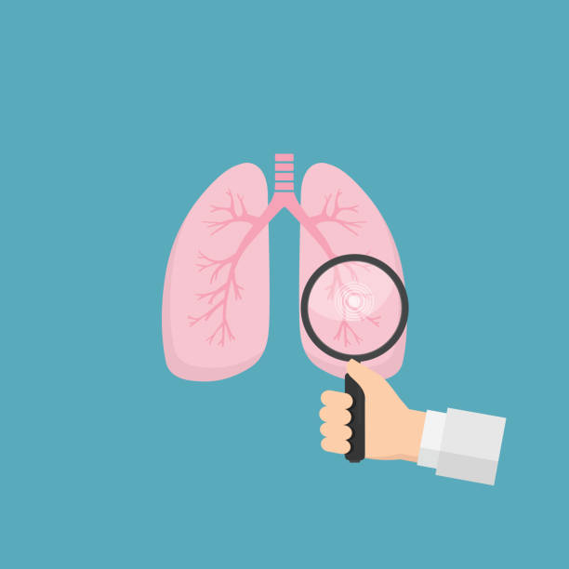
Computer Assisted Diagnosis (CAD)
Automatic systems developed to assist doctors and radiologists
Nowadays, Deep Learning models are used to build such systems
Deep Learning methods for object detection require an annotated training dataset ^{[3]}
[3] Litjens, G et al. . A survey on deep learning in medical image analysis. Medical image analysis (2017)

Slide 4

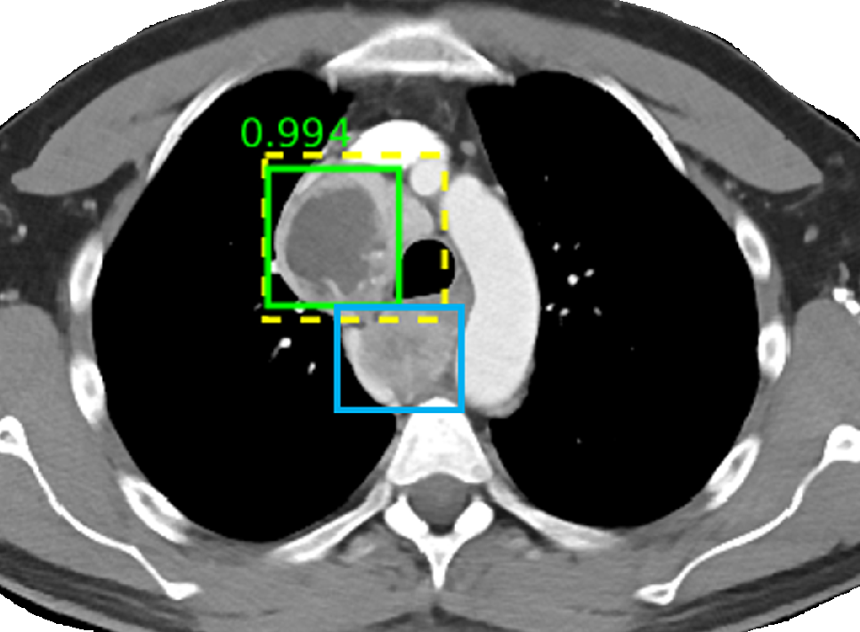

Problem of training datasets for automated systems
CNNs require substantial data to train which is scarce in medical imaging ( 1000 scans for LIDC-IDRI, 1.2 million images for ImageNet)
High number of False positives produced by CAD systems
Expensive and difficult to manually annotate large scale dataset by medical experts and validate CAD results

Slide 5

Crowdsourcing by non-experts
Several studies have been conducted related to crowdsourcing large-scale image annotations using non-experts^{[4]}
Due to its success, it has recently been applied in the medical domain as well ^{[5]}
Although medical image annotation has challenges like task complexity and domain knowledge, it has shown promising results
It is fast, inexpensive and scalable
[4] Kovashka, A., Russakovsky, O., et al (2016). Crowdsourcing in Computer Vision.(survey) Foundations and Trends® in Computer Graphics and Vision,
[5] Doyle A .H et al. “A survey of crowdsourcing in medical image analysis ”. (2019)

Slide 6
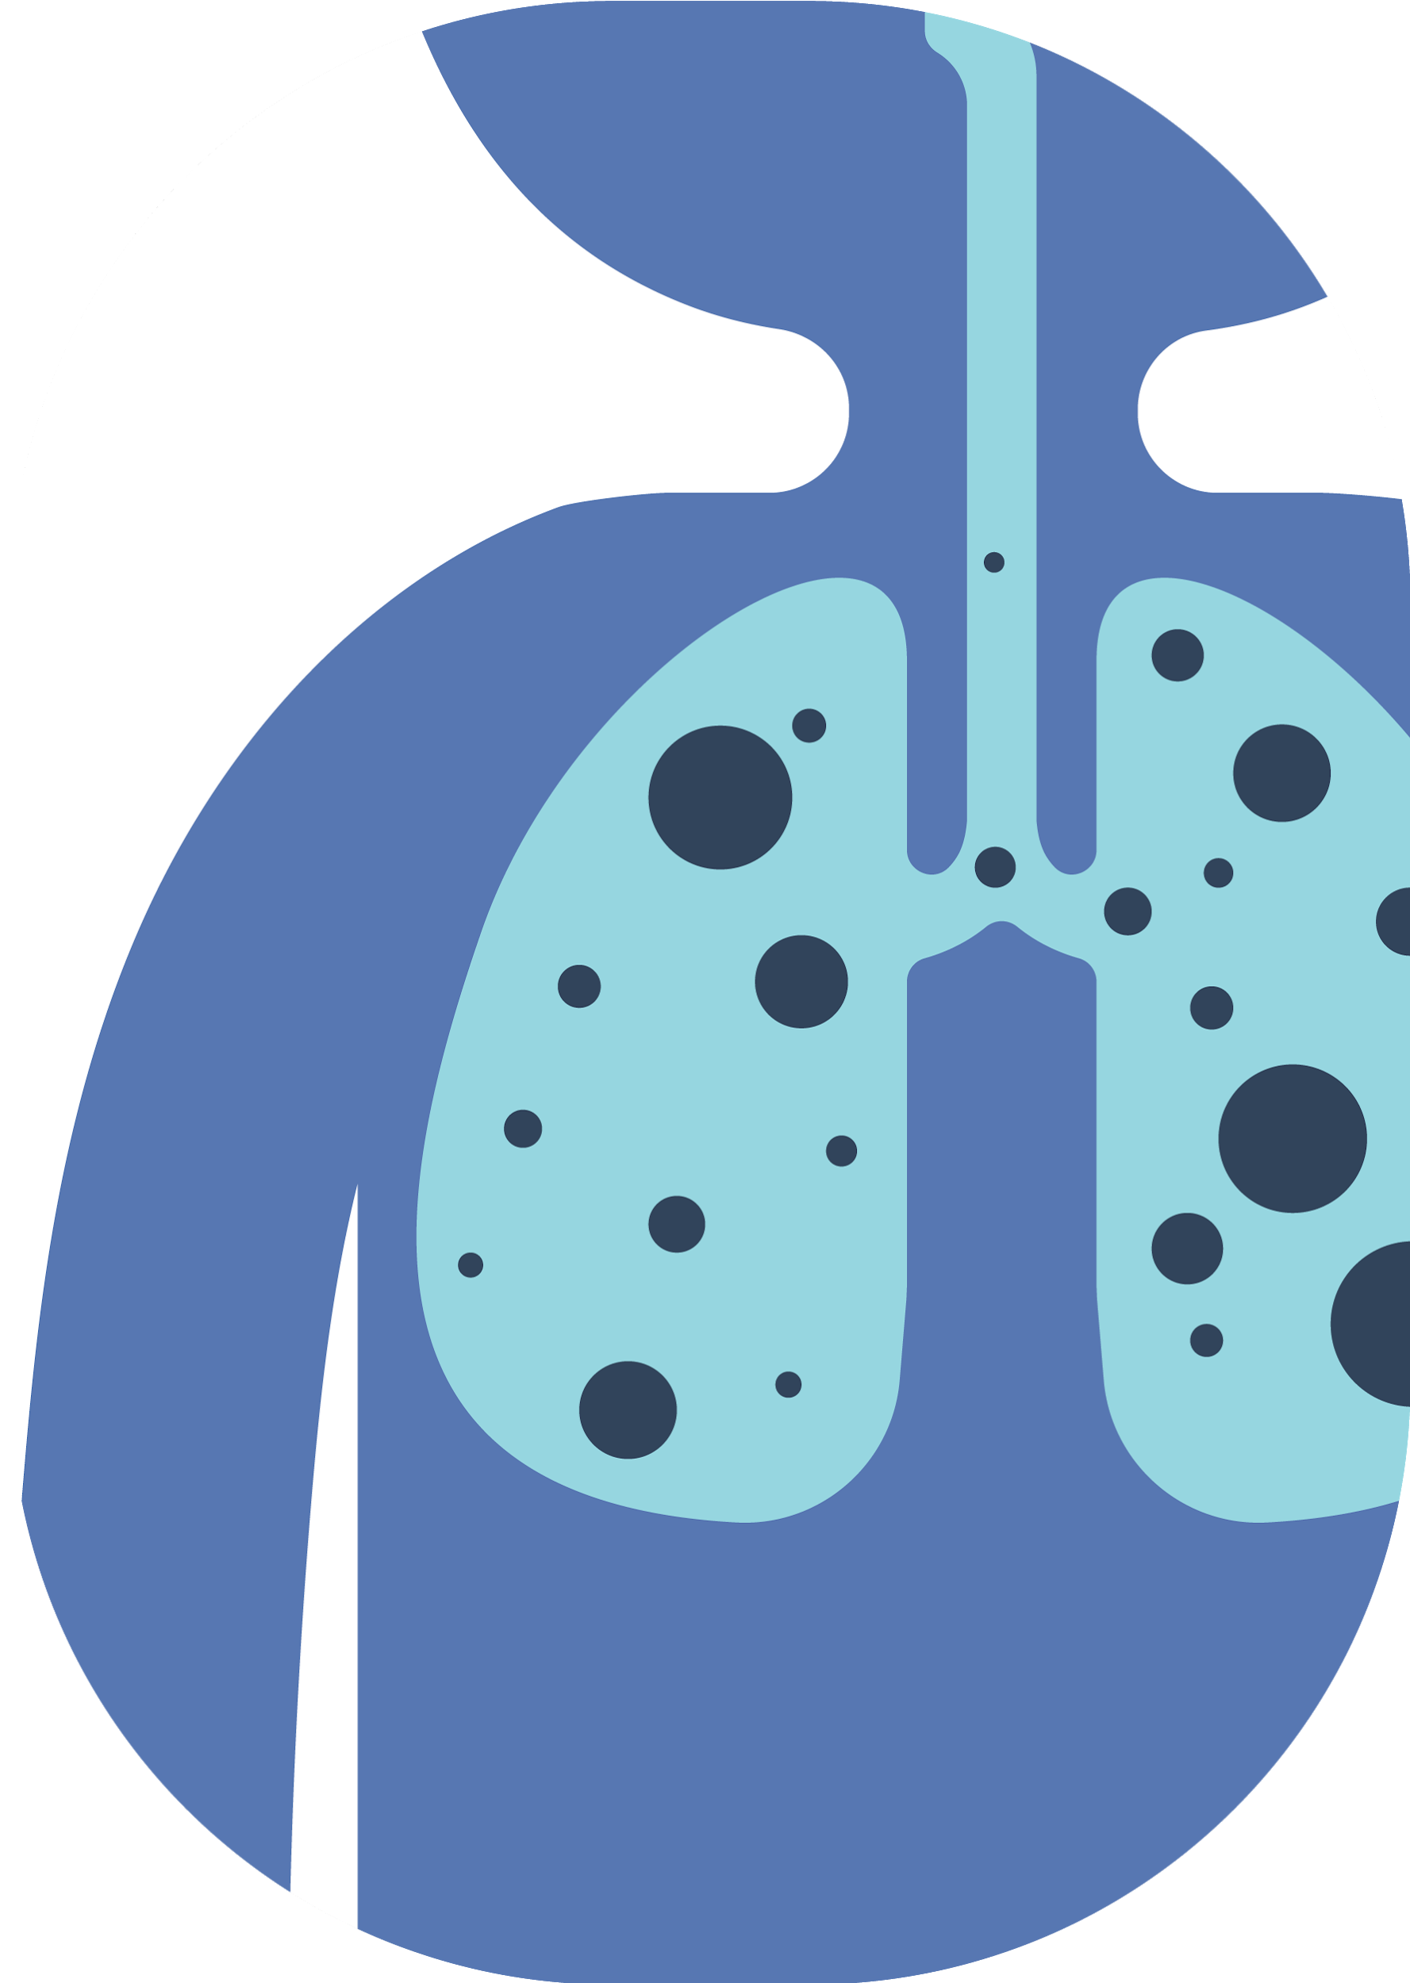
Significance
Improvement in Computer Diagnostic systems for Lung tumor detection will aid as a effective screening tool for clinicians
Precision in determining the location of tumor can improve treatment outcomes and eliminate unnecessary exposure to radiation
Enables patients to be properly informed about each treatment option and has the potential to save lives and increase quality of life for cancer patients
[5] Bradley J Erickson, Panagiotis Korfiatis, Zeynettin Akkus, Timothy L Kline, Machine Learning for Medical Imaging, Radiographics. 2017

Slide 7
Related work
O’Neil et al
Cheplygina et al
Crowdsourcing for medical images
Boorbor S et al
Makaju, S et al.
Zhu, W. et al.
H. Tang et al.
Hossain, S et al.
M. Winkels,Cohen
Rajchl et al.
Xie, X et al
Samuel Budd et al
Computer Assisted Diagnostic
Systems
Active Learning

Slide 8
Review Of Crowdsourcing Using Lung CT Scans
Few scans used for the work (~ 20 scans)
Annotations were not used for any ML tasks
All the subtasks had tumors (positive images), balanced subset was not used
Application
Task design
Results
Limitations
Boorbor et al.
O’Neil et al
Cheplygina
et al
Crowdsourcing airway measurements in chest CT images
610 out of 900 annotations were unusable.
Correlation between worker and expert annotation for usable images was medium to high
Crowdsourcing in lung nodule detection.
Recognizing and segmenting pathological patterns in interstitial lung diseases
Crowd detected 161 out of 178 nodules .Nodule detection sensitivity was 90.4%.
Reference annotations repeated after 10 days to assess reproducibility (DICE-0.806). In most cases, variability of crowd matched radiologist
Segmented lungs into 4 quadrants, generated video of 5 consecutive slices. 80 videos created, 10 workers annotated bounding box per video
308 images annotated (ellipse). 10 images per HIT.10 annotation
Polygon annotation for ROI and assign label of disease. 34 annotators

Slide 9
Research gaps in related work
Research using crowdsourcing with lung CT scans has only been performed on a small scale, no large scale dataset annotation tasks performed
No comparative study is done where the best design parameters for conducting crowdsourcing tasks using lung CT scan is stated
Results have been presented for a single annotation by a worker. Crowd agreement (like majority voting) is not explored in these studies
No end-to-end crowd enabled deep learning models have been developed yet

Slide 10
Research Questions
Can we use non-experts via crowdsourcing to annotate lung cancer nodules accurately?
?
Which type of image representation is most suited for crowdsourcing nodule detection tasks?
1
R1
Does showing the crowd consecutive images in a sequence help them annotate more accurately?
1
R2
How accurately can non-experts annotate lung cancer nodules in comparison to experts?
3
R3
How to locate potential coordinates where crowd agrees that a nodule exists?
3
R4

Slide 11
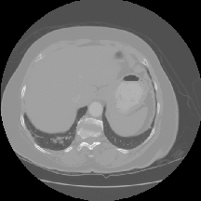
Dataset
The LUNA16 [6] dataset’s annotations consists of the center of the tumor (x,y,z) and its diameter (d) with respect to the 3D .mhd chest CT file.
The LUNA16 subset is a subset of the LIDC-IDRI [7] dataset which consists of 1000 CT scans. Scans less than 2.5 mm in the LIDC-IDRI have been excluded.
Overall, the dataset comprises of 888 total patient scans with 1186 labelled nodules which were collected during a two-phase annotations process using 4 experienced radiologists
[6] “LUNA16 - Grand Challenge. (n.d.).” url:https://luna16.grand-challenge.org/
[7] S. G. Armato et al. “The lung image database consortium (LIDC) and image database resource initiative (IDRI): a completed reference database of lung nodules on CT scans”

Slide 12
Proposed Pipeline
Conduct different crowdsourcing experiments with sample to determine optimal task design to annotate lung nodules
Train DeepLung model using training data obtained from crowdsourcing
LUNA16 dataset
Until accuracy saturates
1
2
3
4
Annotate entire LUNA16 dataset via crowdsourcing using optimal strategy
Human in the loop system to validate false positives

Slide 13
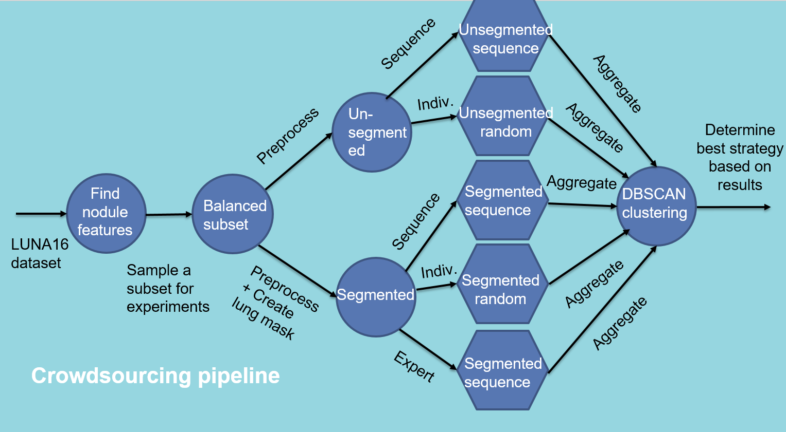

Slide 14
Which type of image representation is most suited for crowdsourcing nodule detection tasks?
R1

Slide 15

Crowdsourcing design parameters
Parameters for presentation of tasks:
Type of image (Segmented / Unsegmented )
Sequence/Static presentation
Type of annotation (Point of interest)
To determine which combination of design parameters is best for conducting a large scale annotation task, we conducted multiple experiments.

Slide 17
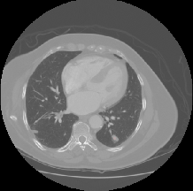
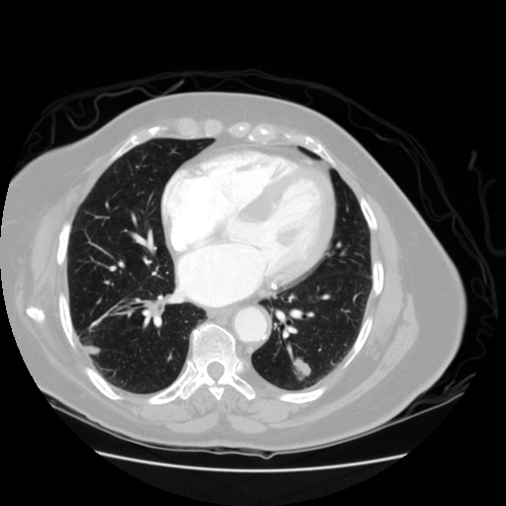
Preprocessing
Clip raw data between [-1000,400] HU and linearly transform between [0,1]

Slide 18
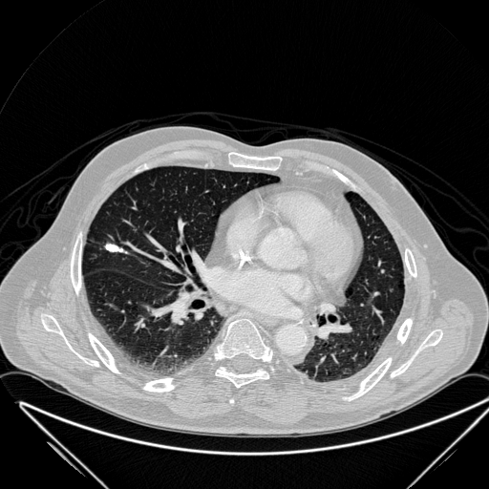

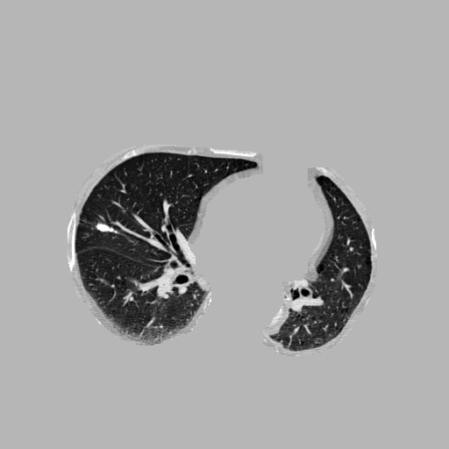
Preprocessing (Segmentation)
Unsegmented
Lung mask
Segmented
Extract 2D slices from 3D .mhd file of the CT scan
Obtain lung mask by thresholding (KMeans ,nclusters=2)
Perform erosion and dilation to eliminate noise and improve segmentation
Apply a cmap gray filter and save as .png file (both segmented and unsegmented)

Slide 19
Crowdsourcing design parameters
Parameters for presentation of tasks:
Type of image (Segmented / Unsegmented )
Sequence/Static presentation
Type of annotation (Point of interest)
To determine which combination of design parameters is best for conducting a large scale annotation task, we conducted multiple experiments.

Slide 20
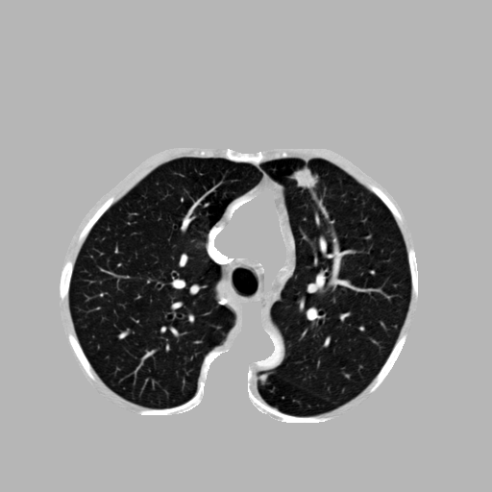



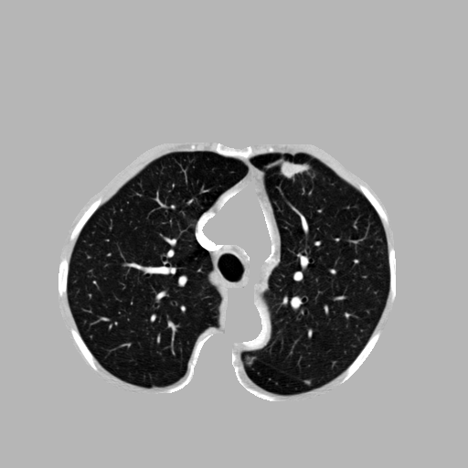
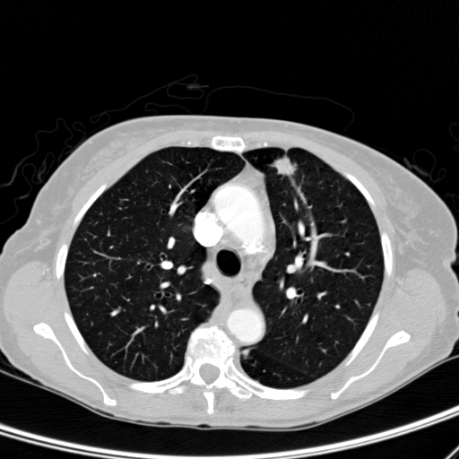


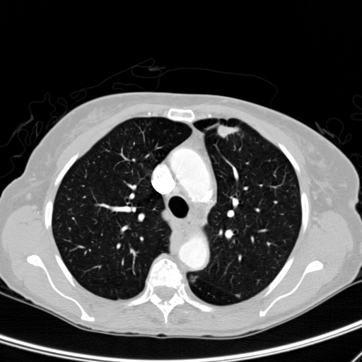

The four experiments
Segmented Sequence
Segmented Static
Unsegmented Sequence
Unsegmented Static

Slide 21
Crowdsourcing design parameters
Parameters for presentation of tasks:
Type of image (Segmented / Unsegmented )
Sequence/Static presentation
Type of annotation (Point of interest)
To determine which combination of design parameters is best for conducting a large scale annotation task, we conducted multiple experiments.

Slide 22
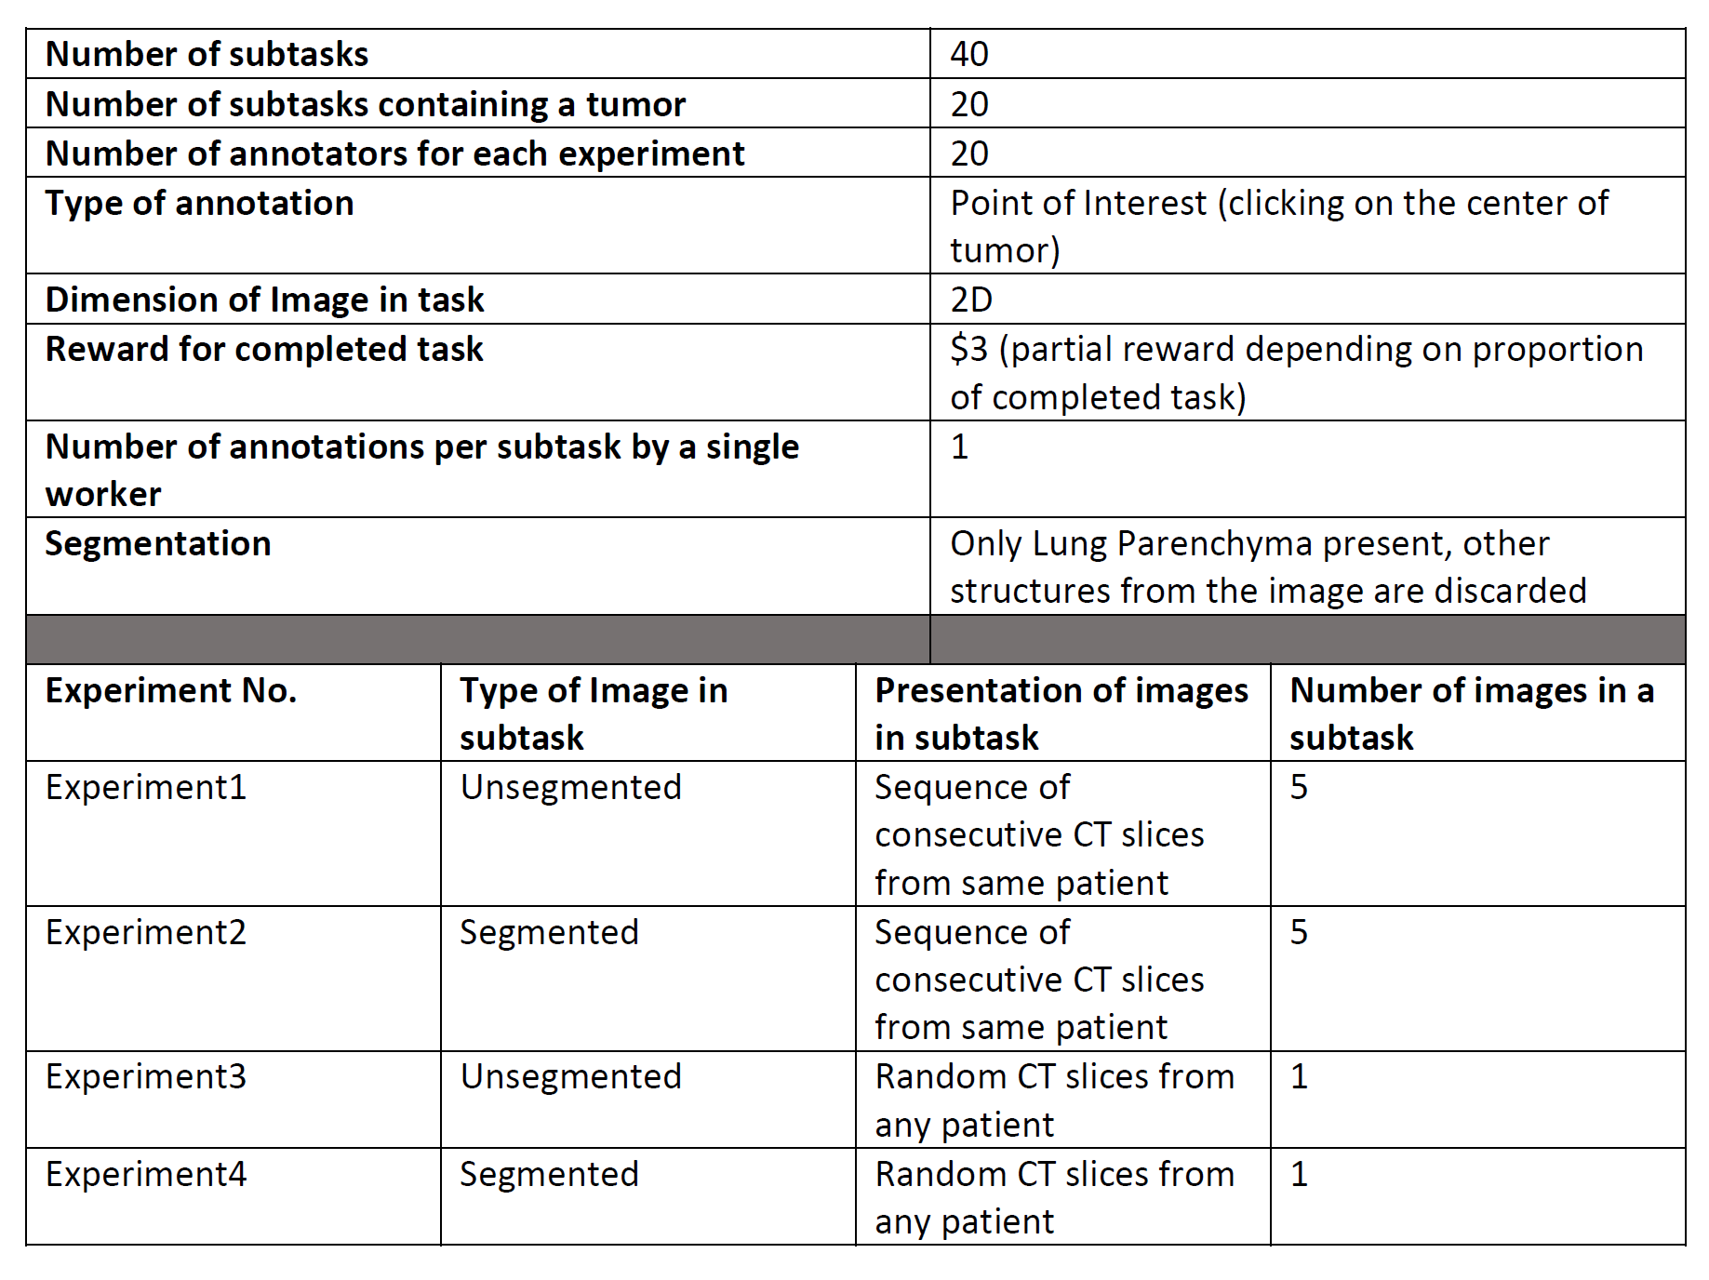
Parameters for Crowdsourcing

Slide 24
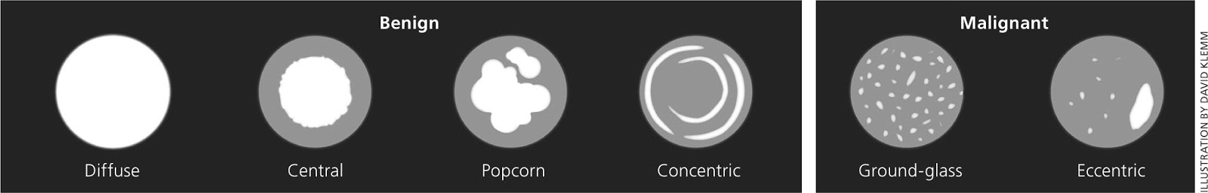
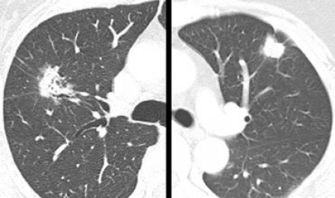
Sample selection for the experiments
In the LIDC-IDRI [8] dataset, the radiologists rated nodule . Characteristics based on their physical appearance on a Scale of 1-5.
These characteristics included:
Subtlety
Internal structure
Calcification
Sphericity
Margin
Lobulation
Spliculation
Texture
Malignancy level
[8] S. G. Armato et al. “The lung image database consortium (LIDC) and image database resource initiative (IDRI): a completed reference database of lung nodules on CT scans”

Slide 25
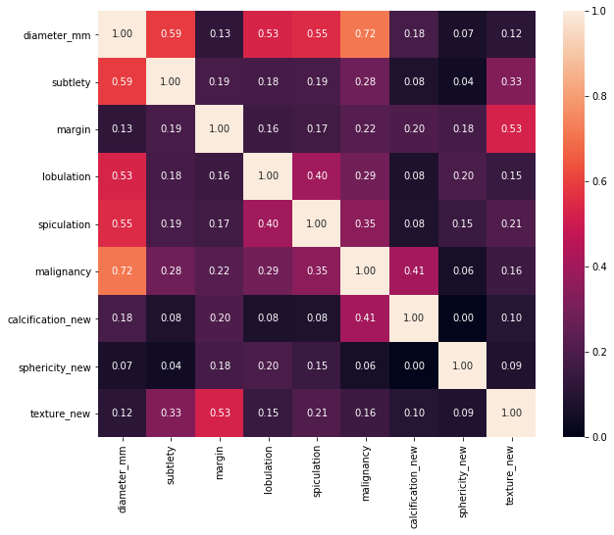
Sample selection for experiments
To determine the most prominent parameter for understanding the probability distribution of the dataset, Cramer’s V correlation for nominal variables was applied
Malignancy and Diameter width were the most prominent characteristics
We chose diameter width as our key variable and applied stratified random sampling based on the diameter’s probability distribution to obtain a representative sample of 20 tumor containing samples (positive) and 20 non-tumor containing samples(negative)

Slide 26

Custom Interface
Amazon Mechanical Turk find workers and routes them to our interface
Instructions page with examples of tumors and non-tumor containing slices
Take a tutorial to understand the interface. Feedback provided immediately on annotating wrong locations and cheat option provided.
Task containing of 40 subtasks
On exiting the interface, a unique code generated for payment on Amazon Mturk

Slide 27
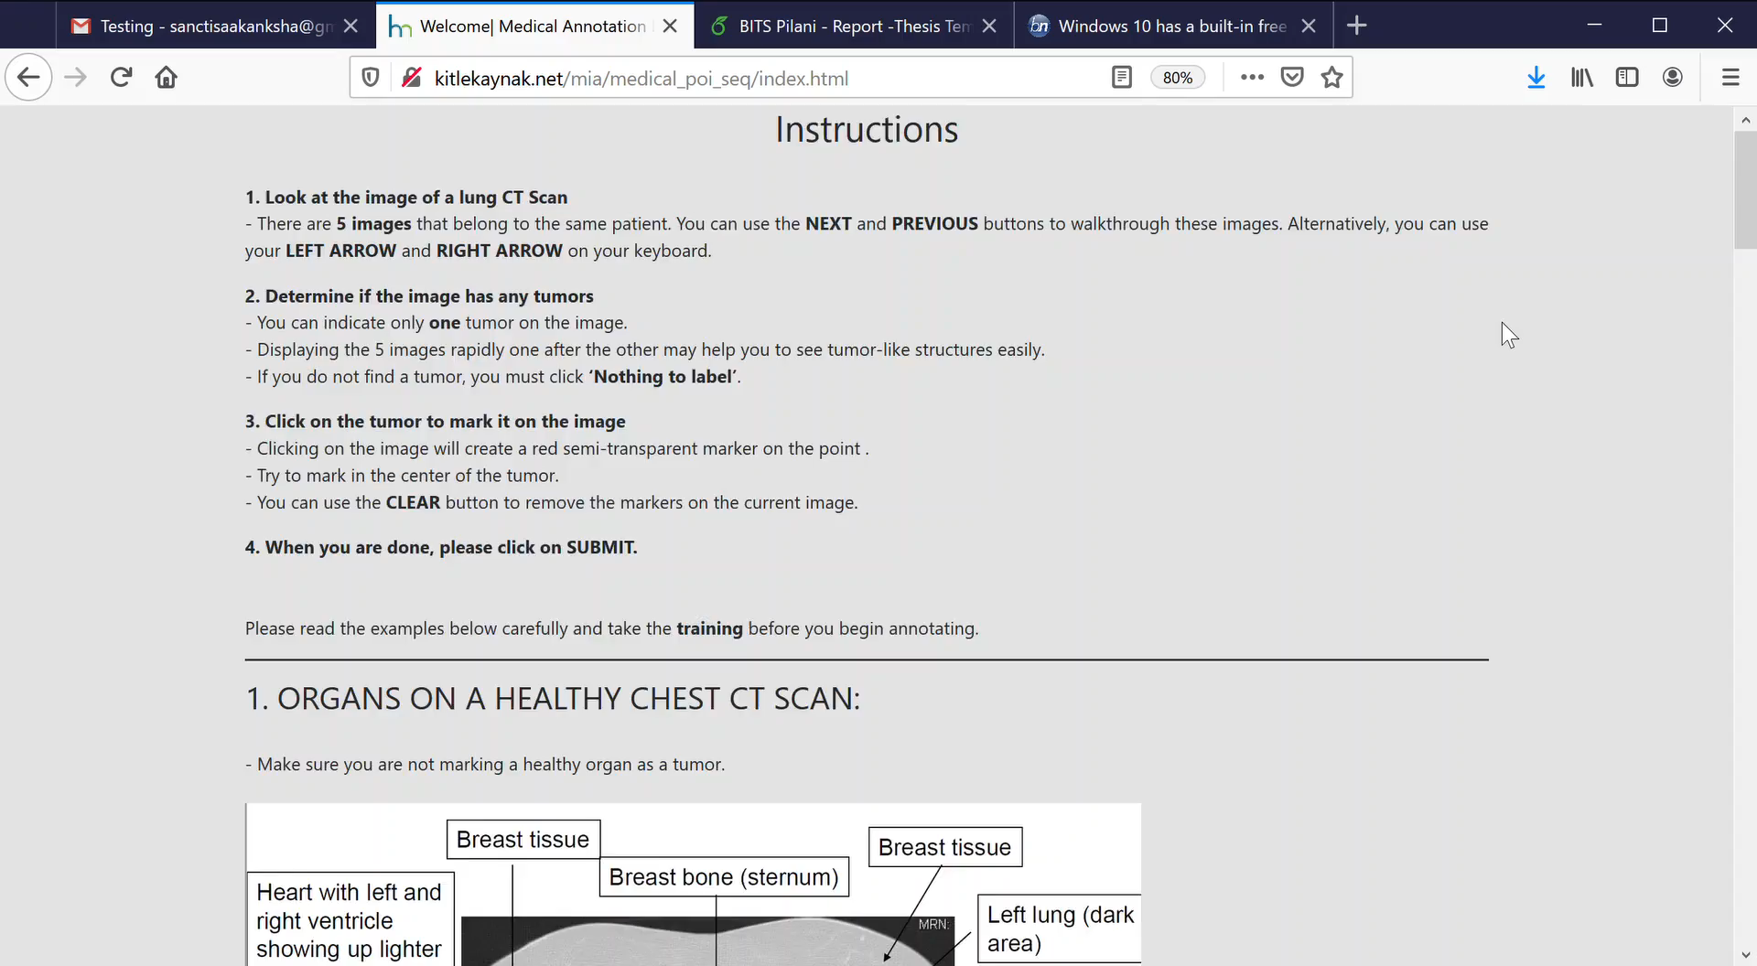

Slide 28
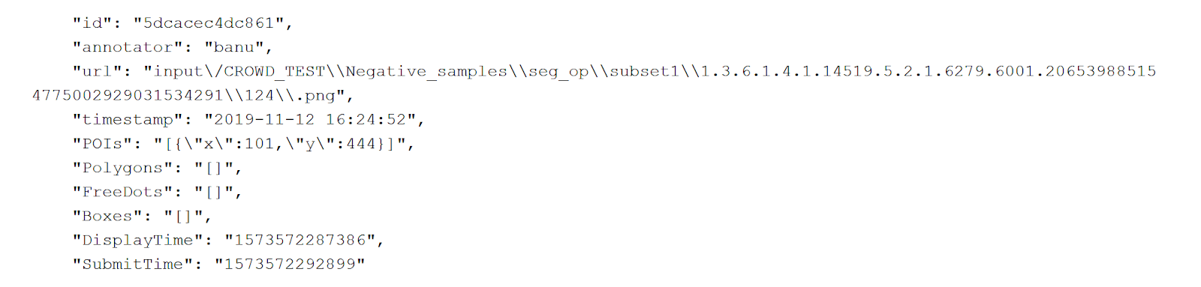
Postprocessing of crowdsourced annotations
Annotations on every image by a worker are collected in json format
‘Nothing to submit’ in case there is no tumor
For quality check:
1. Average time per subtask must lie in the range [7, 100] sec
2. Total number of submission must be > 40/46 and number of annotations indicating a tumor > 10/46
3. Annotations which do not pass the quality checks are discarded

Slide 29
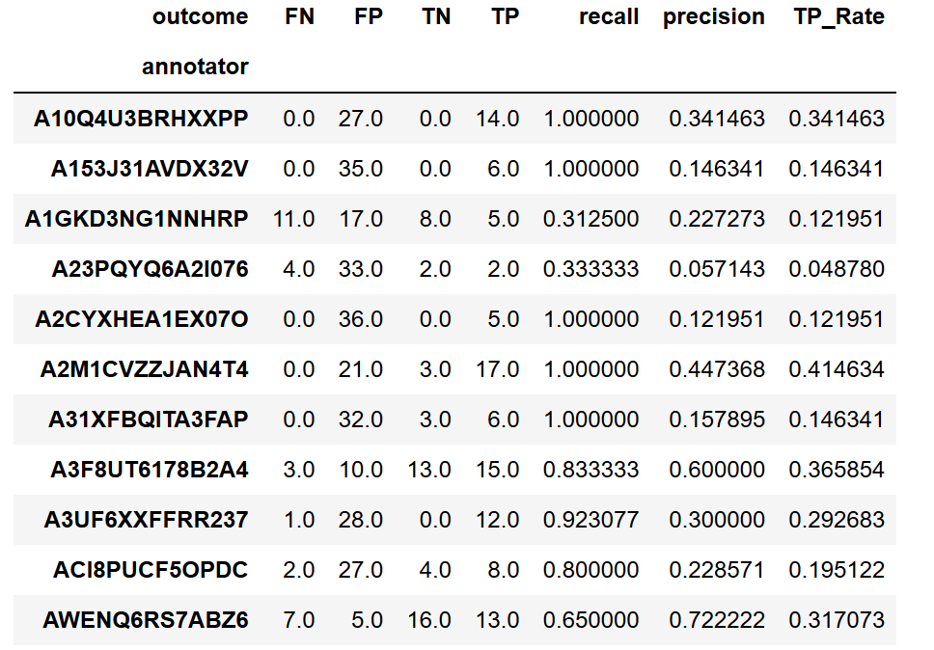
Worker wise performance (Exp 1)
Worker wise performance of unsegmented sequence experiment
For each worker who passes quality checks, TP, FP, TN and FN were calculated
TP - point which lies within 50 pixels of ground truth centroid point of a tumor
FP - point marked where a tumor is not present or a point lying at a distance of more than 50 pixels
TN - image from the negative sample of the subset is submitted as a ’Nothing to submit’
FN - If a tumor containing slice is marked as ’Nothing to submit’
Worker wise performance for unsegmented sequence experiment

Slide 30
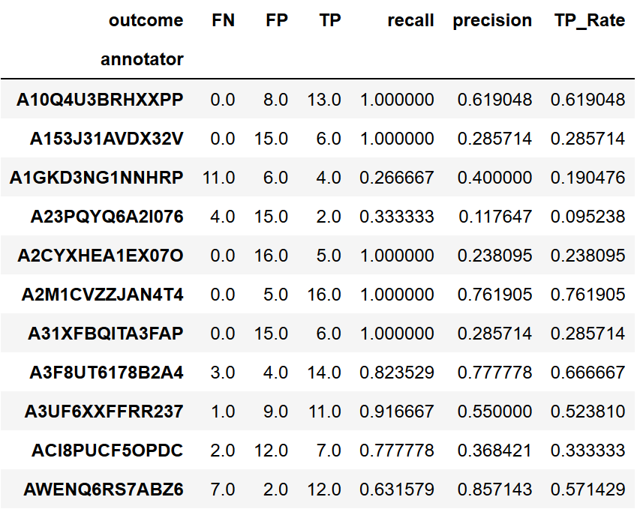
Worker wise performance with only positive sample (Exp 1)
Worker wise performance of unsegmented sequence exp
Workers tend to mark tumor on every image without considering it might belong to the negative sample
High number of False positives
Can be remedied by increasing the number of annotators per image

Slide 31
How accurately can non-experts annotate lung cancer nodules in comparison to experts?
R3

Slide 32
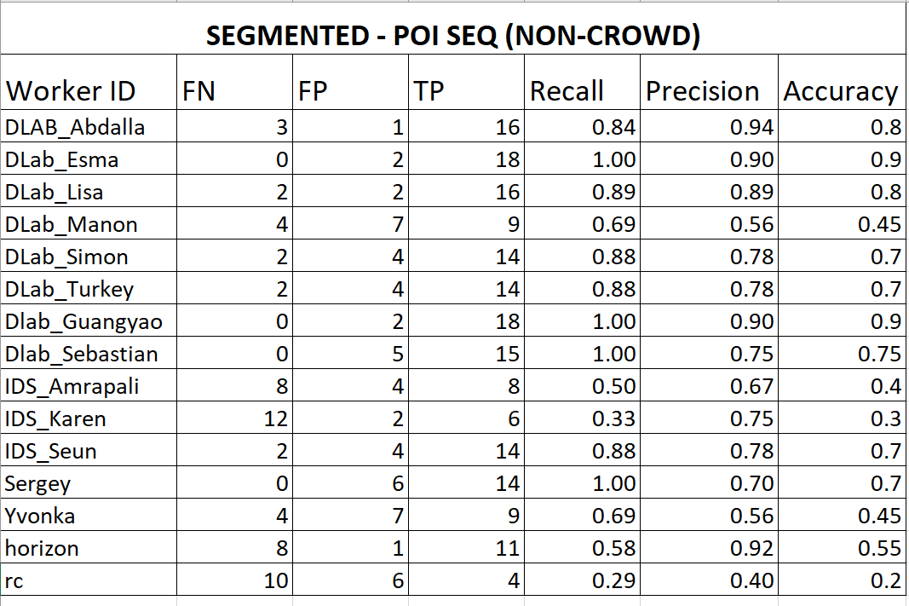
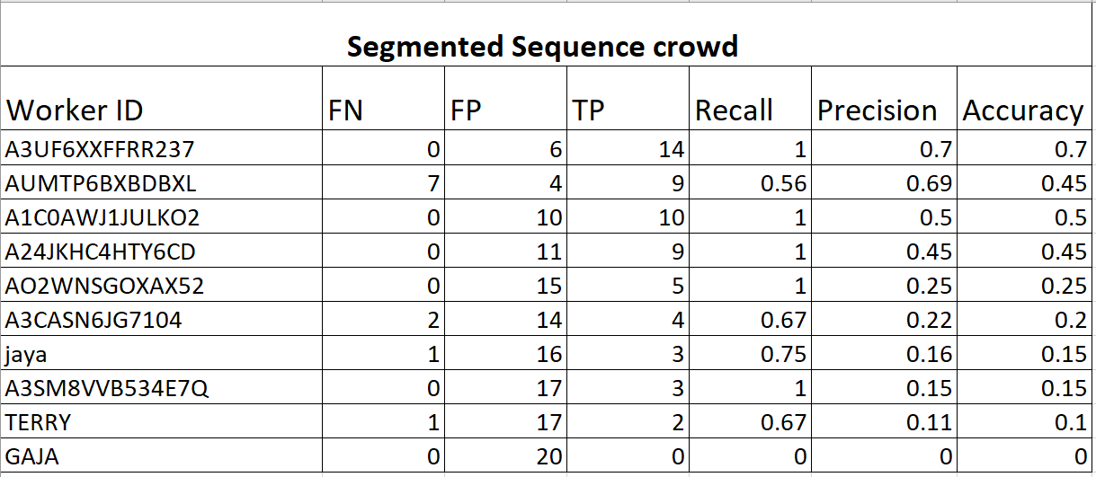
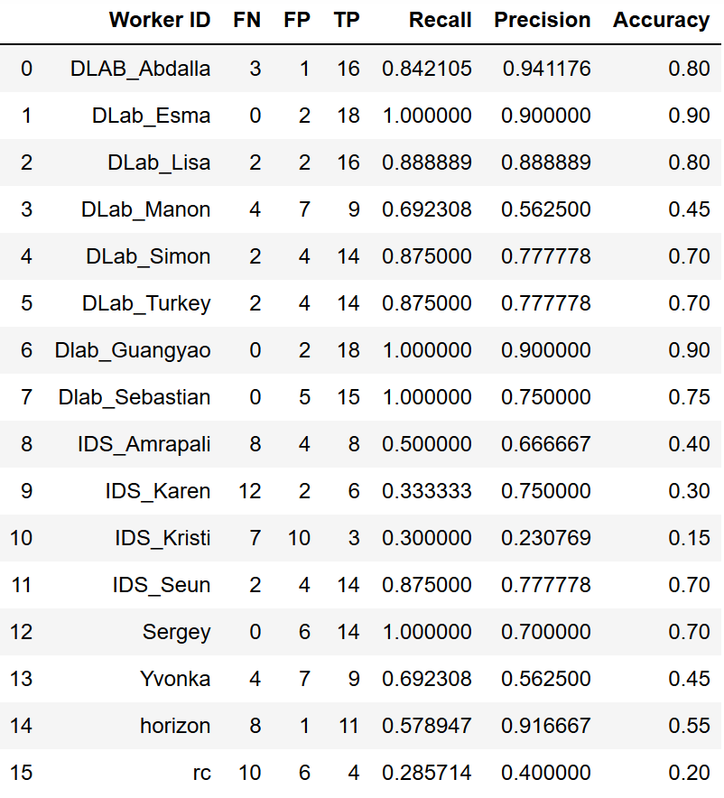
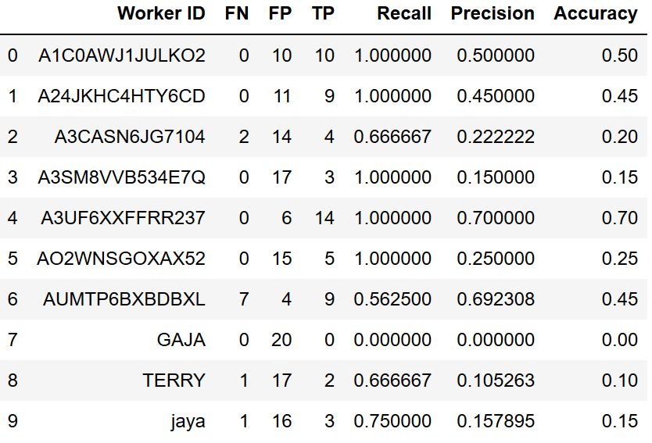
Comparison with experts (Exp 2)
Non-experts
Expert
Segmented sequence tasks

Slide 33
How to locate potential coordinates where crowd agrees that a nodule exists?
R4

Slide 35
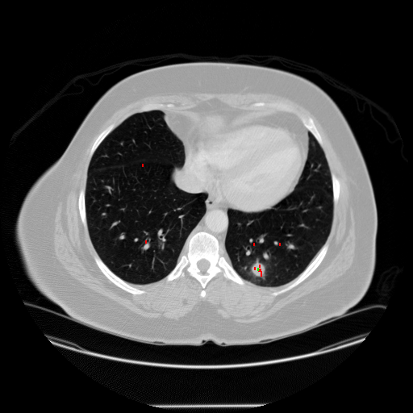
Aggregation of crowdsourced annotations per image
Most of the annotations were around a potential tumor like structure
DBSCAN clustering algorithm applied to every set of annotations per image
From labels obtained from DBSCAN, centroids of points belonging to the same cluster were calculated
Points labelled as -1 did not belong to any cluster and were considered outliers

Slide 36
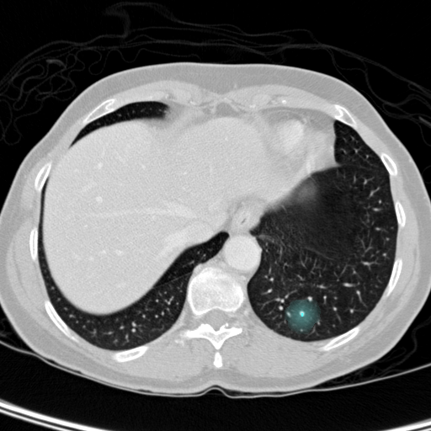
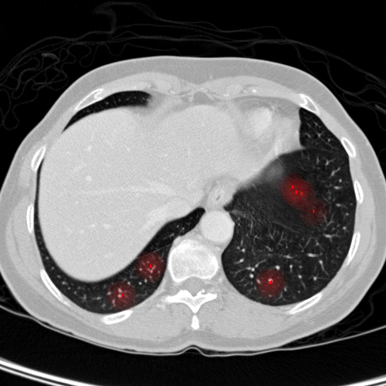
Negative samples with crowd disagreements (TN)
DBSCAN
ALL
DBSCAN
ALL

Slide 37
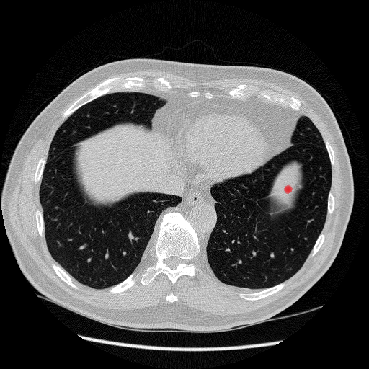
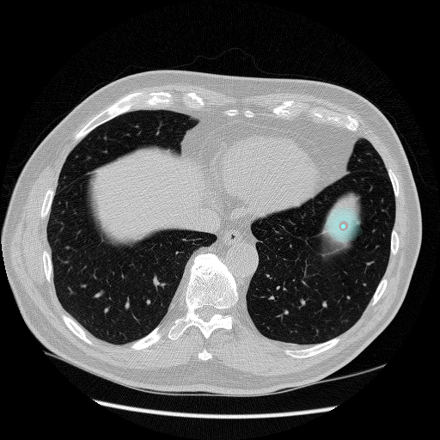
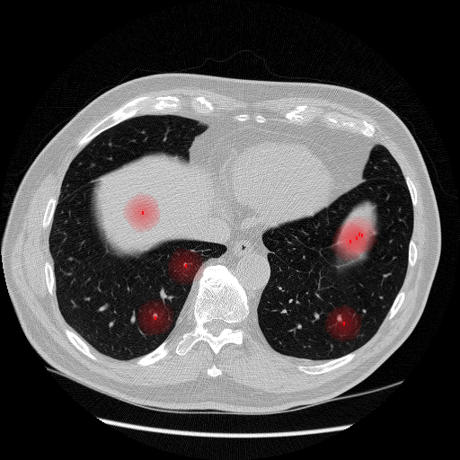
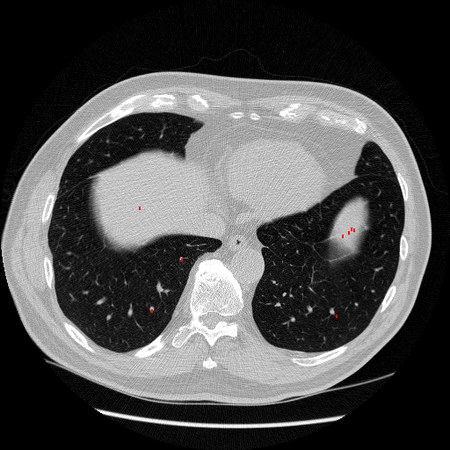
Negative samples with crowd agreement (FP)
DBSCAN
ALL
DBSCAN

Slide 38
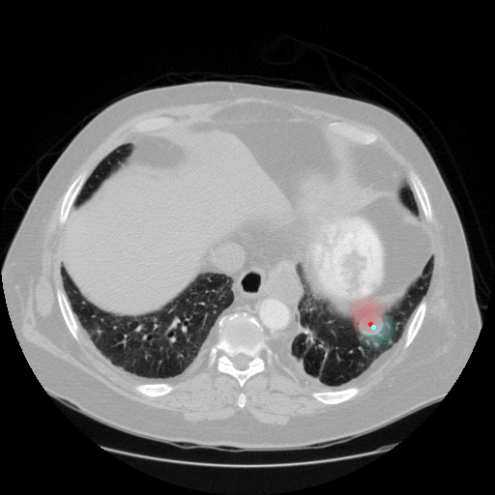
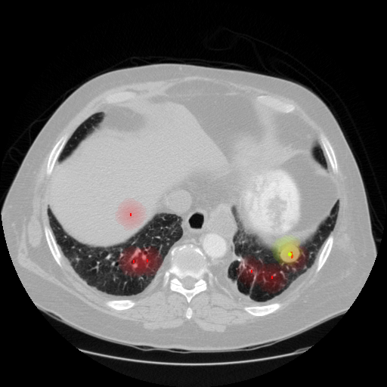
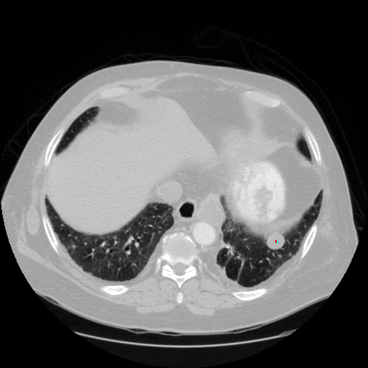
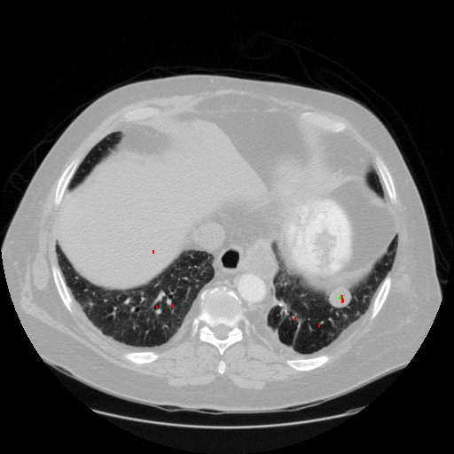
Positive samples with crowd agreement (TP)
DBSCAN
ALL
DBSCAN
ALL

Slide 39
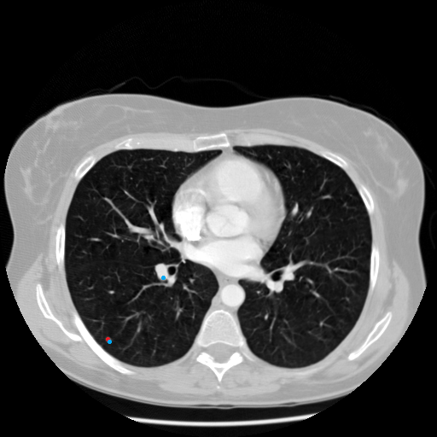
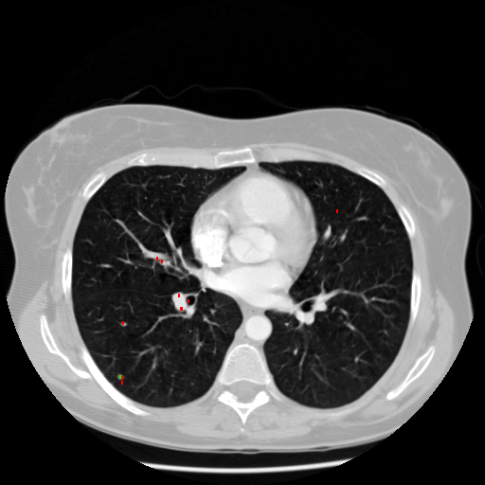
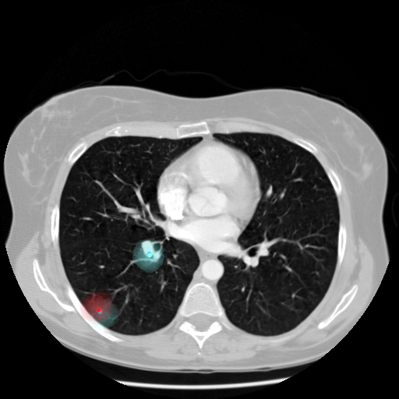
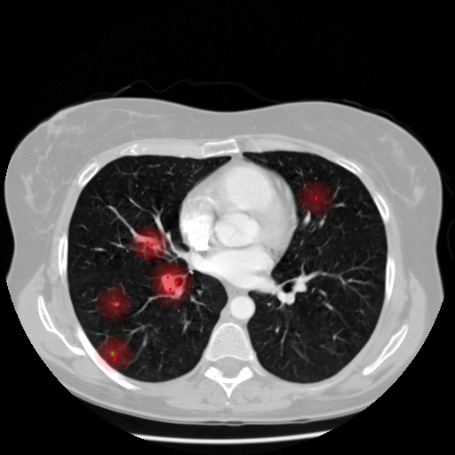
Positive samples with crowd agreement (with FP)
DBSCAN
DBSCAN
ALL
ALL

Slide 40
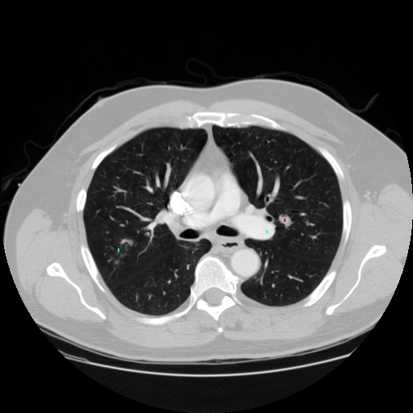
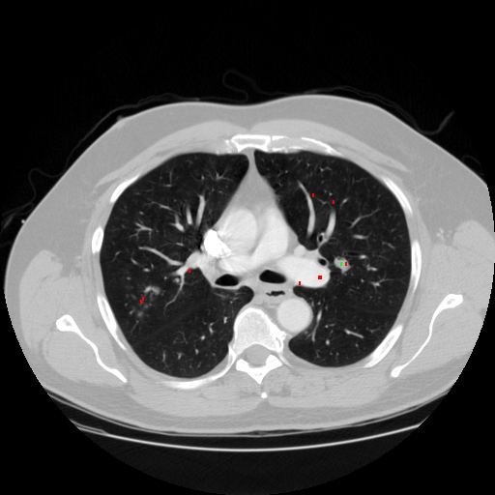
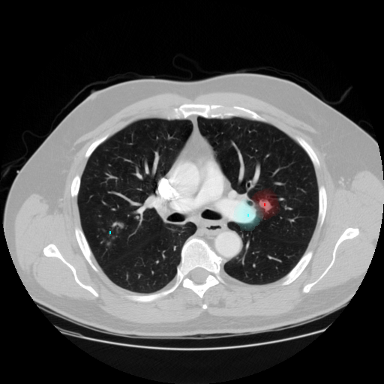
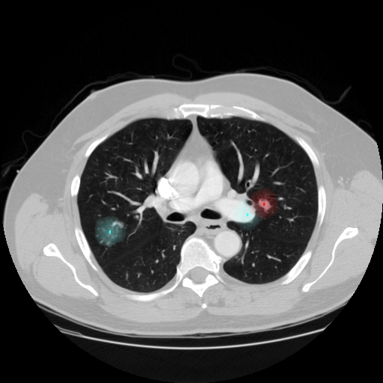
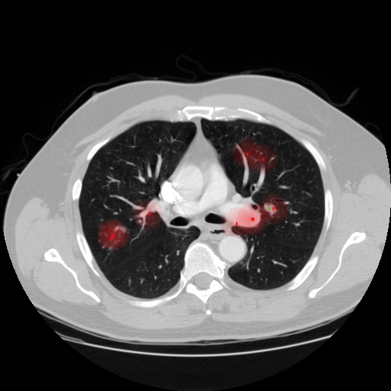
Positive samples with crowd disagreement
DBSCAN
ALL

Slide 41
Does showing the crowd consecutive images in a sequence help them annotate more accurately
R2

Slide 42
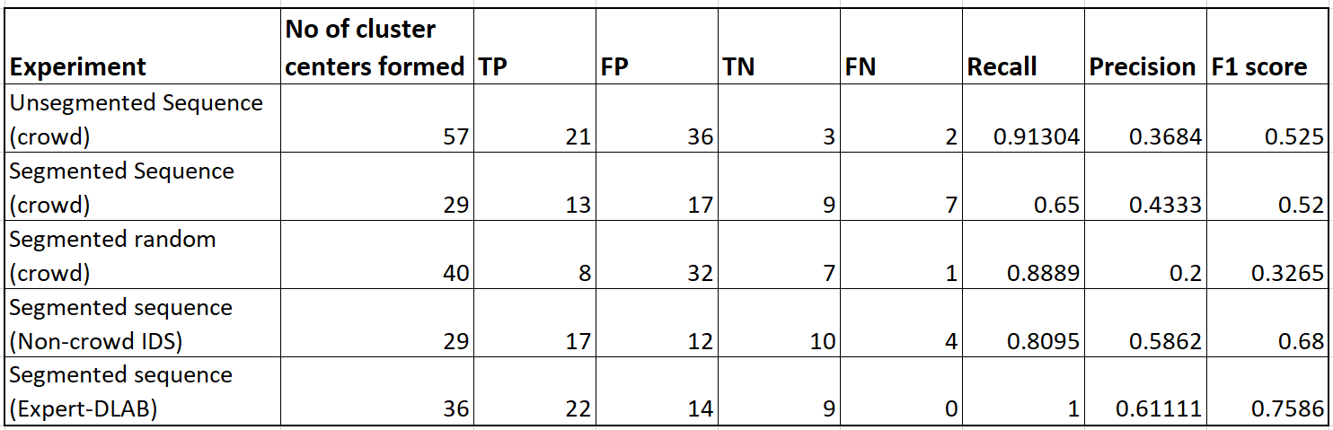
Aggregation results

Slide 43
Next Steps

Slide 44
Proposed Pipeline
Conduct different crowdsourcing experiments with sample to determine optimal task design to annotate lung nodules
Train DeepLung model using training data obtained from crowdsourcing
LUNA16 dataset
Until accuracy saturates
1
2
3
4
Annotate entire LUNA16 dataset via crowdsourcing using optimal strategy
Human in the loop system to validate false positives

Slide 45
Additional research questions
To what extent will deep learning methods using crowdsourcing outperform other known methods ?
1
1
What amount of human intervention and machine computation is optimal to achieve high accuracy?
1
2

Slide 46
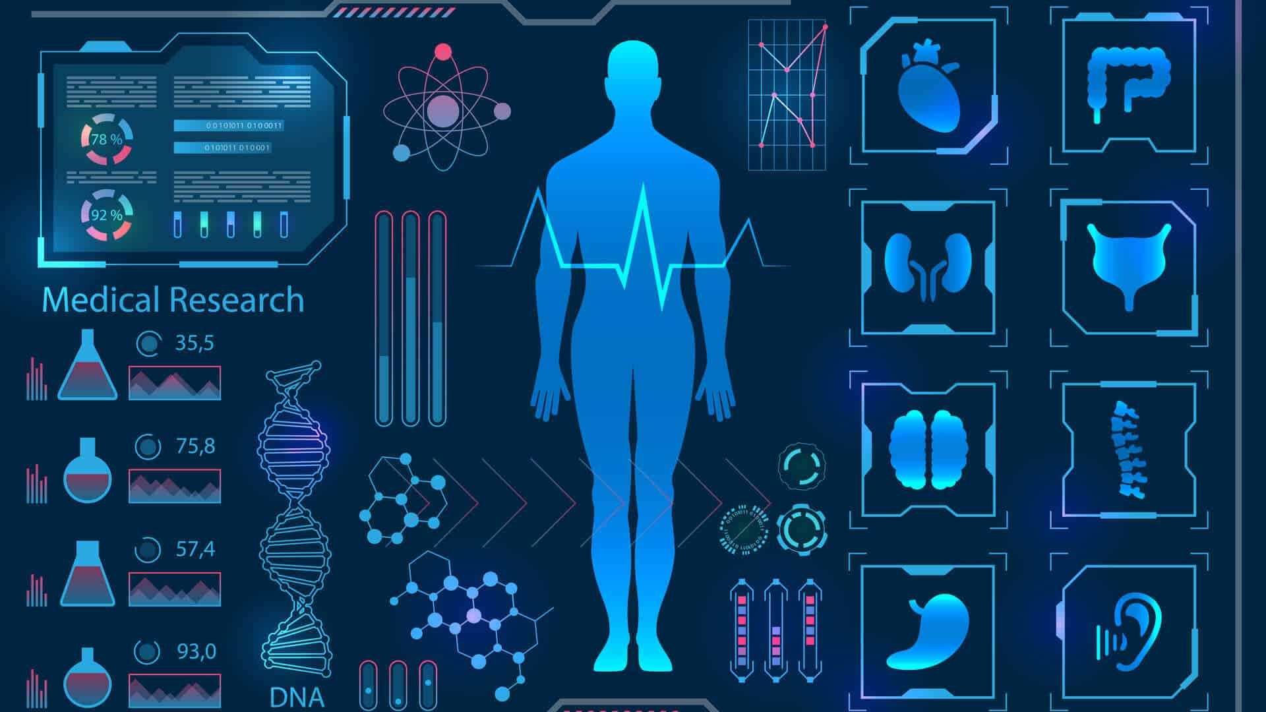
Computer Aided Diagnostic System
Current CT analysis systems consists of
(i) Nodule detection
(ii) Nodule classification
Deep Convolutional neural networks are employed to generate potential bounding boxes.
Some of these works use a encoder-decoder UNet model for Faster R-CNN to generate region proposals in which the tumors might lie.
DeepLung – a 3D Faster R-CNN is designed for nodule
detection with 3D dual path blocks and a U-net-like
encoder-decoder structure to effectively learn nodule features [8]
[8] Liu C. Fan W. Xie X. Zhu W. “DeepLung: Deep 3D Dual Path Nets for Automated Pulmonary Nodule Detection and Classification (2018)

Slide 47
Next Steps
Iteratively train the deep learning model by using active learning (human in the loop system) and improve dataset by removing misclassified nodules
Submit a paper to IEEE Open Access Journal

Slide 48

Model Selection
Dual path networks is a hybrid architecture combining Densely connected convolutional networks (DenseNets) and Residual Networks ( ResNets).
Shortcut connections in ResNets eliminate vanishing gradient problem
DenseNets exploit new features while ResNets encourage feature reuse
Overall uses lesser number of features
G: Activation function (reLU)
x: Input to DPN
y: Feature map output of DPN
F: convolutional layer function
F(x)[d:]: Feature maps of ResNets
F(x)[:d]: Feature maps of DensetNets
D: hyperparameter to determine how many features to exploit

Slide 49

Model
Nodule detection model : 3D Faster R-CNN framework containing 3D dual path networks and UNet encoder decoder structure (26 layers)

Slide 50
Evaluation of Model
10 fold cross validation with patient level split as described in the LUNA16 challenge using our crowdsourced annotations
FROC : Recall rate at average number of false positive at 0.125, 0.25, 0.5, 1, 2 ,4 and 8 per scan is used
Nodule detection model gives us the bounding box coordinates and the probability that the patch is a nodule.
Based on a decided threshold, all detected patches with probability less than the threshold will be validated by a expert/crowd and training set will be improved iteratively (crowd annotations will have high number of false positives)

Slide 51
Summary
Four experiments which were performed inferred that sequence subtasks produced better results than individual static images
Unsegmented sequence task emerged to be the best strategy for annotation, even though number of FP is still high
Aggregation tasks using DBSCAN clustering produced cluster centers which are close to the ground truth
Problem of false positives and more accurate cluster centers could be potentially solved by increasing the number of annotators per image

Slide 52
Research Questions
Can we use non-experts via crowdsourcing to annotate lung cancer nodules accurately?
?
Which type of image representation is most suited for crowdsourcing nodule detection tasks?
1
R1
Does showing the crowd consecutive images in a sequence help them annotate more accurately
1
R2
How accurately can non-experts annotate lung cancer nodules in comparison to experts?
3
R3
How to locate potential coordinates where crowd agrees that a nodule exists?
3
R4

Slide 53
Innovation
End to end crowd engineered deep learning pipeline for lung nodule detection
Comparative study of different type of task design for medical annotation tasks
Large scale annotation of medical images by crowd at lower costs

Slide 54
References
Murchison J. T. Beek E. J. R. V. Goatman K. A. O’Neil A. Q. “Crowdsourcing Labels for Pathological Patterns in CT Lung Scans: Can Non-experts Contribute Expert-Quality Ground Truth?” In: Lecture Notes in Computer Science Intravascular Imaging and Computer Assisted Stenting, and Large-Scale Annotation of Biomedical Data and Expert Label Synthesis (2017), 96–105.
Nadeem S. Park J. H. Baker K. Kaufman A. 2. Boorboor S. “Crowdsourcing lung nodules detection and annotation. ” In:
Medical Imaging 2018: Imaging Informatics for Healthcare, Research, and Applications. (2018). Perez-Rovira A. Kuo W. Tiddens H. A. W. M. Bruijne M. D. Cheplygina V. “Early Experiences with Crowdsourcing Airway Annotations in Chest CT.” In: Deep Learning and Data Labeling for Medical Applications Lecture Notes in Computer Science (2016)
Liu C. Fan W. Xie X. Zhu W. “DeepLung: Deep 3D Dual Path Nets for Automated Pulmonary Nodule Detection and Classification
Xie X. Shen-L. Liu S. Li Y. “Reverse active learning based atrous DenseNet for pathological image classification ”. In: (2019)

Slide 55

THANKS
Any Questions ?

